Slide 1

Scope Management
/02
Stakeholder Management
Technology Management

Slide 2








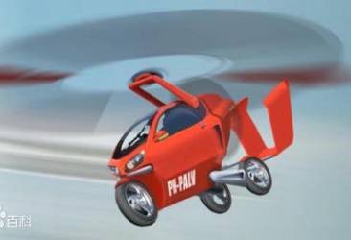
Stakeholders
Sponsor
Colleges
Team
Members
Customers

Slide 3
Support for Project
Stakeholders
Opposed to project
Indifferent or uncertain
Supporters of project
Civil Aviation Administration of China
National Aeronautics and Space Administration
High
Railway Department
French Aviation Administration
Power of Influence
Medium
The Boeing Company
Airlines
Airbus
American Car Companies
Chinese and French Car Companies
General Motors
Low
Ford Motor Company
Maintenance Company
Citroen
Wolkswagen
………
Tesla Motors
……..
Blockers
Floating Voters
Champions

Slide 4

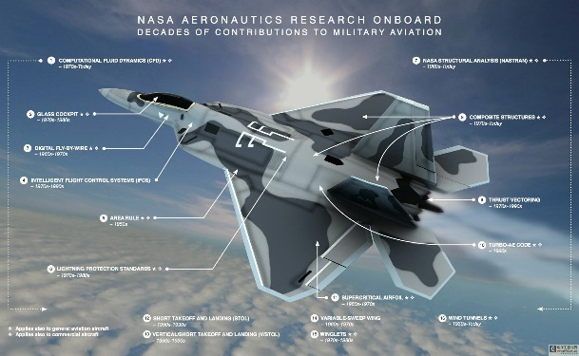
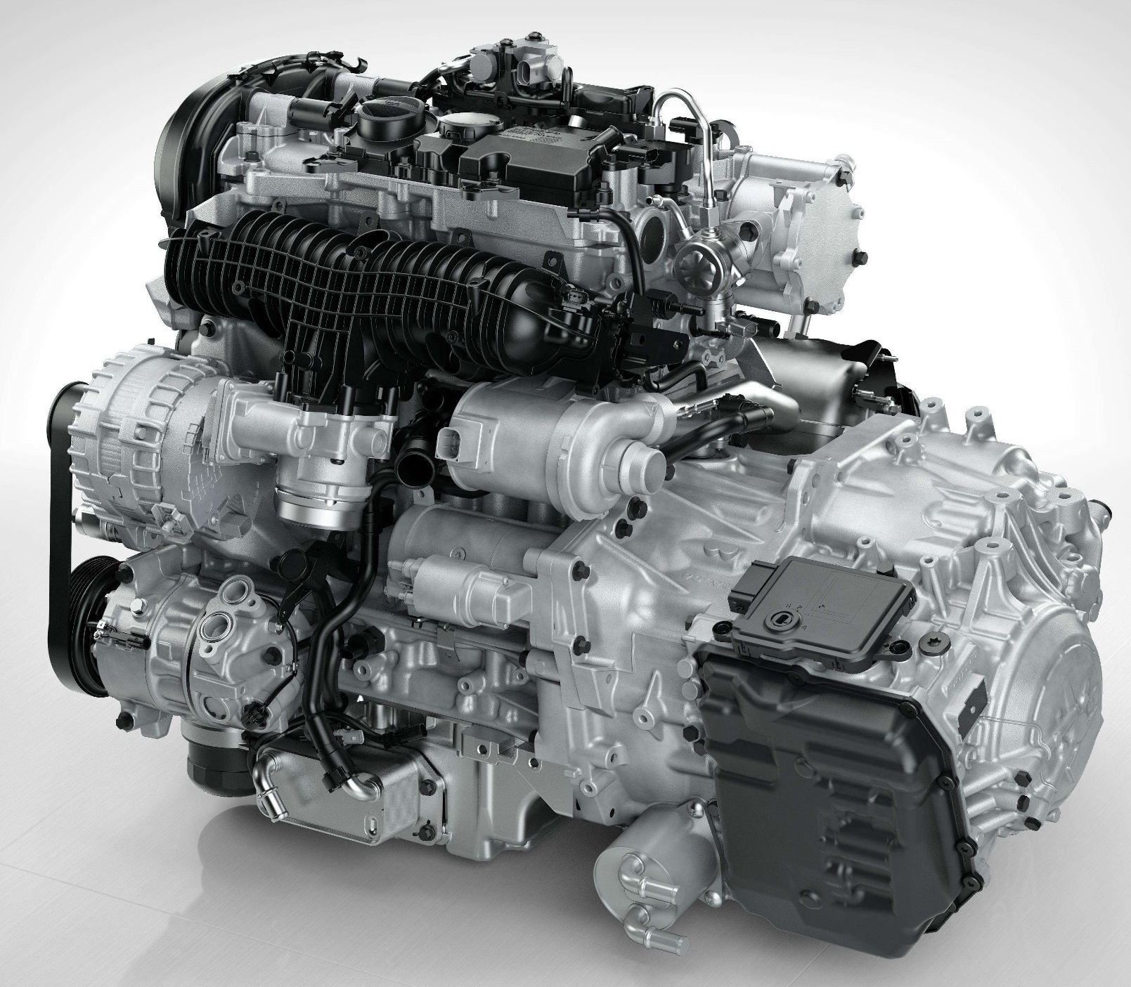
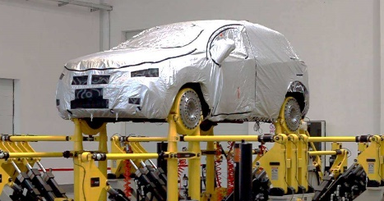
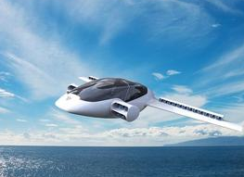
Technology Management
Flight
control
system
Material
Engine
Test-analysis
Modeling

Slide 5
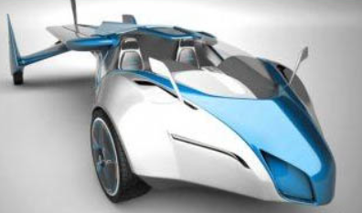
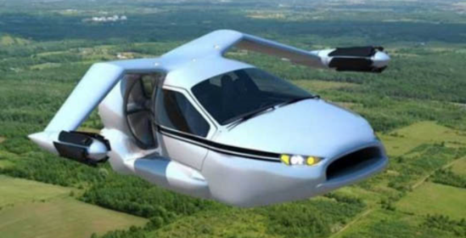
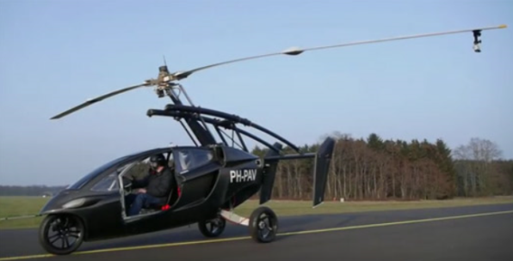
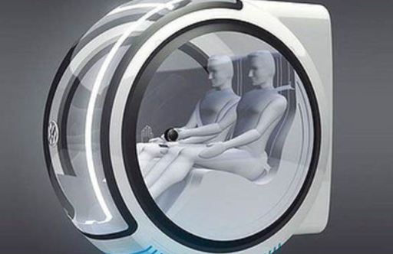
Modeling

Slide 6
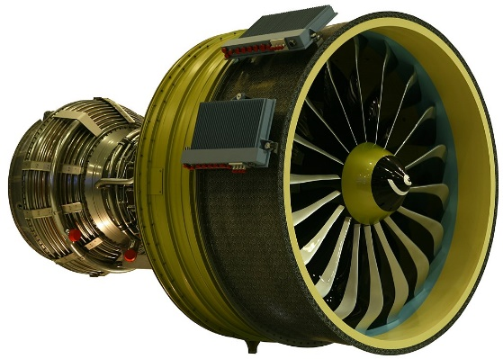
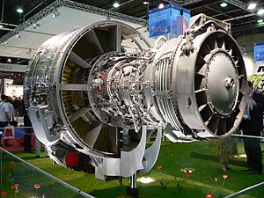
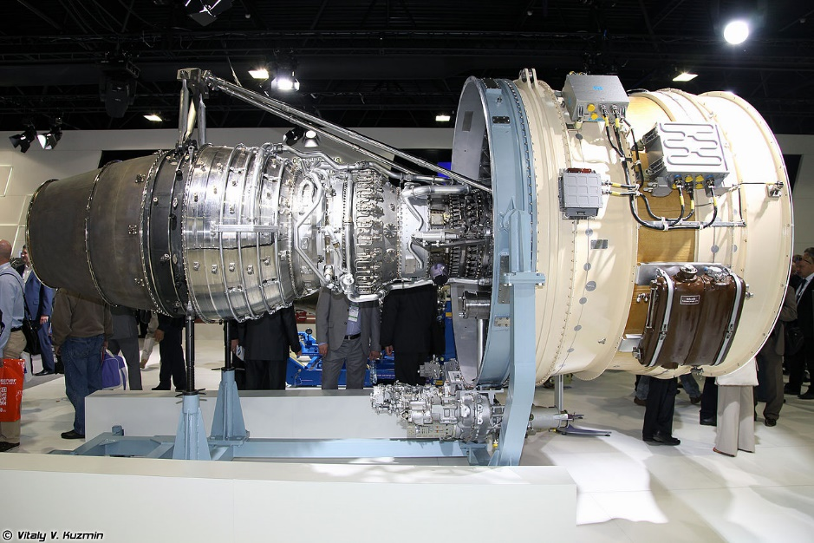
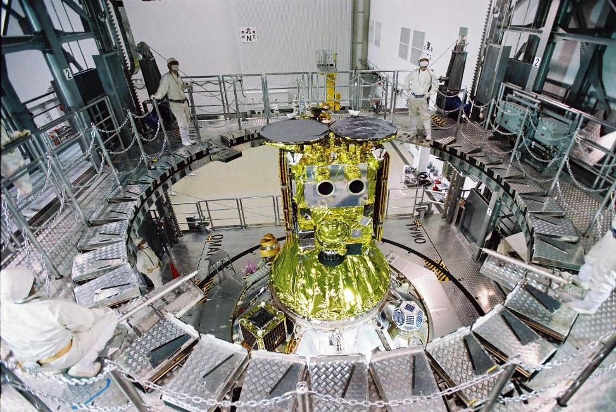
Engine
Leap-1B
CFM56
PD-14
……….
Ion Engine
Pulsed inductive engine
Magneto plasma dynamic engine
Magneto plasma dynamic engine
……….

Slide 7

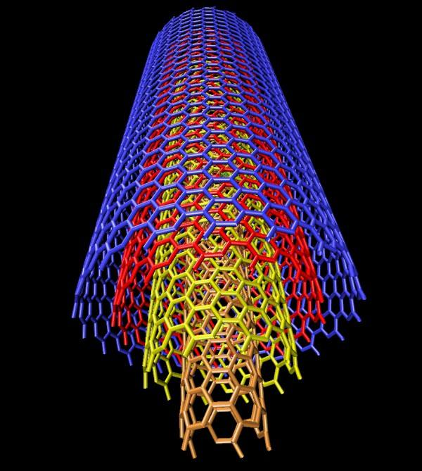
Material
Alloy
01
Excellent engineering properties
Tensile strength
Shear strength
Young’s modulus
Composite Material
02
Excellent mechanical properties
Unique electronic property
Special magnetic property
Good absorption properties
Unique optical performance

Slide 8
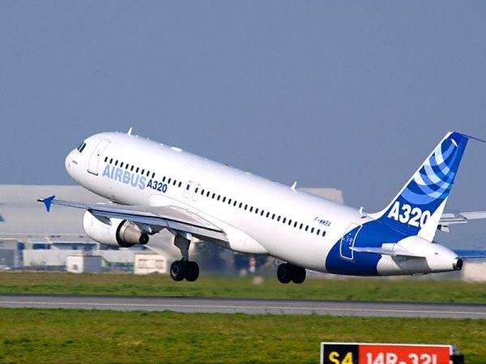

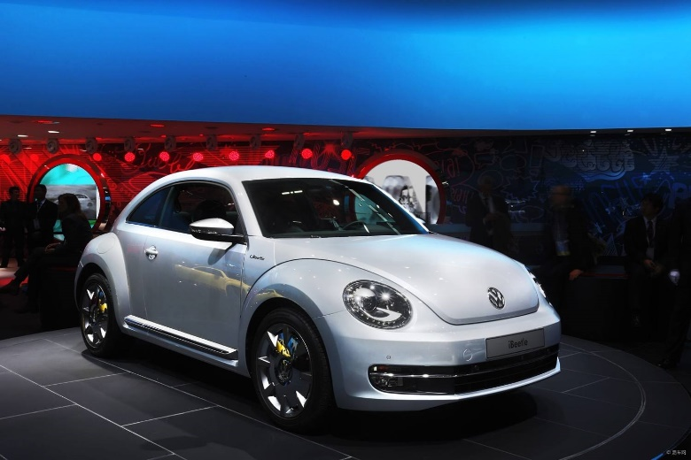

Flight Control System
Unmanned Control

Slide 9
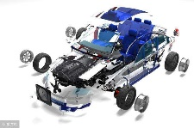
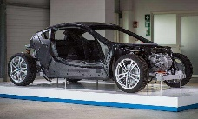
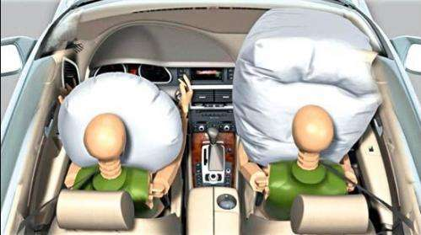
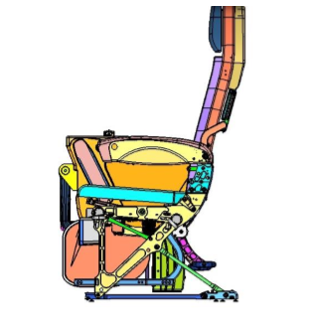
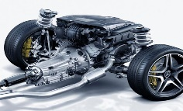
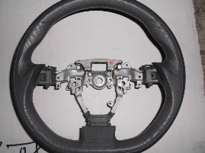
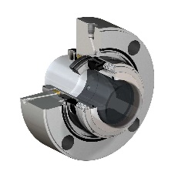
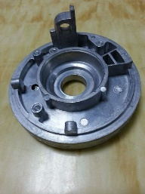
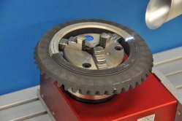
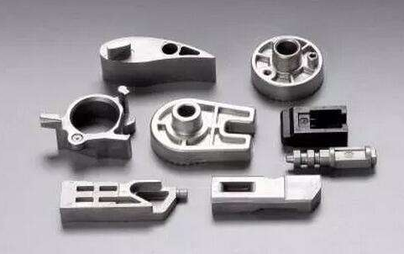
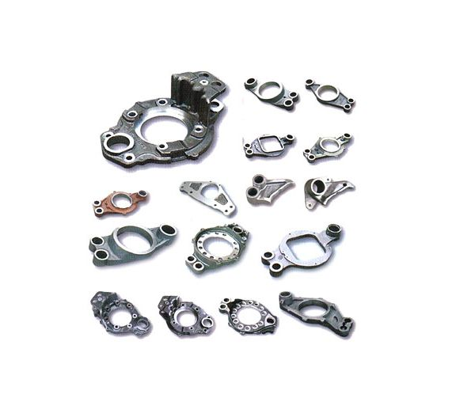
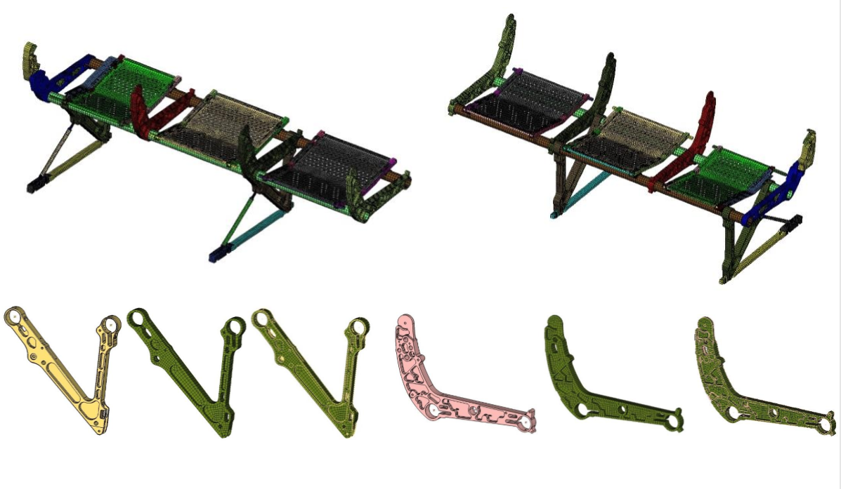
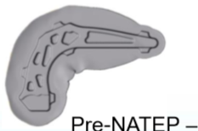
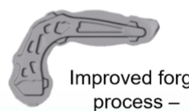
Test-analysis
Validation & Verification
Full System
Sub-System
Component
Structural Details
Coupon
Test
Simulation

